Slide 1

CPE 431/531 Chapter 6 – Parallel Processors from Client to Cloud
Dr. Rhonda Kay Gaede

Slide 2
6.1 Motivation
Why multiprocessors?
_performance_
_power efficiency_
_fault tolerance_

Slide 3
6.2 The Difficulty of Creating Parallel Programs
The difficulty with parallelism is not the _hardware_ , it’s the _software_.
Why is it difficult to write parallel processing programs that are fast?
_scheduling_
_load_ _balancing_
_synchronization_ _time_
_communication_ _overhead_
_Amdahl’s_ _law_

Slide 4





6.2 Speedup Challenge
Suppose you want to achieve a speedup of 90 times faster with 100 processors. What percentage of the original computation can be sequential?
$\frac{ET affected}{Amount of improvement}$+ET unaffected = ET after
Speedup = $\frac{ET before}{ET after}$
90 = $\frac{ET b}{\left(ET b −ET aff\right)+ET aff/100} \frac{\frac{1}{ETb}}{\frac{1}{ETb}}$
fract= $\frac{ET aff}{ET b}$
90 = $\frac{1}{1 −fract+fract/100}$
90 – 90 fract + 0.9 fract = 1
89 = 89.1 fract
Fract = 0.999
Sequential = 1 – fract = 0.001 = 0.1%

Slide 5
6.2 Speedup Challenge – Bigger Problem
Suppose you want to perform two sums: one is a sum of 10 scalar variables and one is a matrix sum of a pair of two-dimensional arrays, size 10 by 10. What speedup do you get with 10 versus 40 processors?
Scalar 10t
Matrix 100 r
ET before = 110 t
10 processors
ET after = 10t + 110t/10 = 20t
Speedup = 110t/20t = 5.5
Efficiency = 5.5/10 = 55%
40 processors
ET aff = 10t + 100t/40 = 12.5t
Speedup = 110t/12.5t = 8.8
Efficiency = 8.8/40 = 22%

Slide 6
6.2 Speedup Challenge – Bigger Problem
Next, calculate the speed-ups assuming the matrices grow to 20 by 20
Strong scaling – measure speedup with fixed problem
Weak scaling – program size grows proportionally to the number of processors
How many additions? 400t Still doing scalar sum of 10
10 processors
Original Time = 410t
Parallel Time = 10t + 400t/10 = 50t
Speedup = 410t/50t = 8.2
40 processors
Parallel Time = 10t + 400t/40 = 20t
Speedup = 410t/20t = 20.5

Slide 7
6.2 Speedup Challenge: Balancing Load
To achieve the speed-up of 20.5 on the previous larger problem with 40 processors, we assumed the load was perfectly balanced (each processor did 2.5 % of the work). Instead, show the impact on speed-up if one processor’s load is higher than all the rest. Calculate at 5% and 12.5%.
5% load
P5% = 20t
39 processors share 380t
Max (20t, 380t/39) + 10t = 30t
Speedup = 410t/30t = 13.67
12.5% load
P12.5% = 50t
39 processors share 350t
Max (50t, 350t/39) + 10t = 60t
Speedup = 410t/60t = 6.83

Slide 8
6.3 SISD, MIMD, SIMD, SPMD, and Vector
SISD is the normal case – single instruction, single data.
MIMD – multiple instruction, multiple data - is _theoretically_ possible but programmers normally write a _single_ _program_ that runs on all processors relying on _conditional_ statements when _different_ processors should execute _different_ sections of code. This style is single _program_, multiple data.
SIMD – single instruction, multiple data – operate on _vectors_ of data. SIMD needs only _one_ _copy_ of the code that is being simultaneously executed. SIMD works best when dealing with _arrays_ in _for_ loops.
The _array_ _processors_ that inspired the SIMD category faded into history but two _current_ interpretations of SIMD remain _active_ today.
_SIMD in x86 Multimedia Extensions_
_Vector_

Slide 9
6.3 x86 Multimedia Extensions
The most _widely_ used variation of SIMD is the basis of the hundreds of MMX and SSE instructions of the x86 processor. These instructions were added to improve performance of _multimedia_ programs.
The hardware allows flexible ALU operations – one 64-bit or two 32-bit or four 16-bit or eight 8-bit
Loads and stores are simply as wide as the widest ALU.
SSE now supports simultaneous execution of a pair of 64-bit floating-point numbers

Slide 10
6.3 Vector
An older and more elegant interpretation of SIMD is called a vector architecture, which has been closely identified with Cray Computers.
Consider Y = a × X + Y
Original
l.d $f0,a($sp)
addiu $t1,$s0,#512
loop: l.d $f2,0($s0)
mul.d $f2,$f2,$f0
l.d $f4,0($s1)
add.d $f4,$f4,$f2
s.d $f4,0($s1)
addiu $s0,$s1,#8
addiu $s1,$s1,#8
subu $t0,$t1,$s0
bne $t0,$zero,loop
Vector
l.d $f0, a($sp)
lv $v1,0($s0)
mulvs.d $v2,$v1,$f0
lv $v3,0($s1)
addv.d $v4,$v4,$v3
sv $v4,0($s1)
Notes:
Execute only 6 instructions instead of 600
No hazards, in original each mul.d must wait for a l.d
The size of the operand is stored in a register
Original 64 x 9 + 2 instructions

Slide 11
6.3 Comparisons
Vector versus Scalar
A _single_ _vector_ instruction specifies a great deal of work, the instruction _fetch_ and _decode_ bandwidth is greatly reduced.
Hardware does not have to check for _data_ _hazards_ _within_ a vector instruction.
Vector architectures and compilers have worked well for _data-level_ _parallelism_.
Hardware need only check for _data_ hazards _once_ between two vector _instructions_, not _once_ for every _vector_ _element_.
Vector instructions that access memory have a _known_ _access_ _pattern_, memory system can be adjusted accordingly.
Replacing a _loop_ with a _vector_ _instruction_ reduces _control_ hazards.
Vector versus Multimedia Extensions
Vector specifies the number of operands in _registers_, not in _opcodes_.
Vector data transfers need _not_ be _contiguous_.
Vector _evolves_ over time more _gracefully_.
Notes:
The data transfers need not be contiguous, the addresses are kept in a vector register. Indexed loads gather elements from main memory into contiguous vector elements and indexed stores scatter vector elements across main memory.

Slide 12
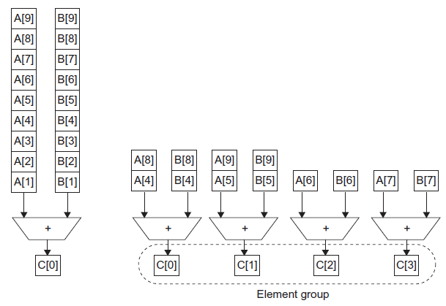
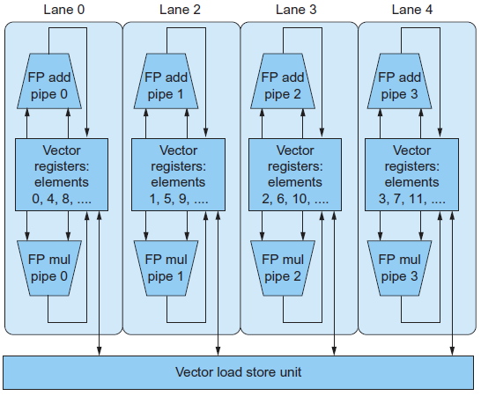
6.3 Improving the Performance of Vector

Slide 13
6.4 Hardware Multithreading
Hardware multithreading allows _multiple_ _threads_ to _share_ the _functional_ units of a single processor in _overlapping_ fashion.
The processor must _duplicate_ the independent _state_ of each _thread_.
The hardware must support the _ability_ to _change_ to different _thread_ relatively quickly.
_Fine-grained_ multithreading switches between _threads_ on each _instruction_, often done round robin.
Hides _throughput_ losses by doing useful work during _thread_ _stalls_.
Inserts _latency_ for threads with _no_ _stalls_.
_Coarse-grained_ multithreading _switches_ threads only on _costly_ stalls, such as _second-level_ _cache_ misses.
It is limited in its ability to overcome _throughput_ losses, especially from _shorter_ stalls. The major problem is pipeline _fill_ _time_.

Slide 14
6.4 Simultaneous Multithreading
Simultaneous multithreading uses the resources of a _multiple-issue_, _dynamically_ scheduled processor to exploit _thread-level_ parallelism at the same time it exploits _instruction-level_ parallelism.
The key insight is that multiple-issue processors often have more _functional_ _unit_ _parallelism_ than a _single_ thread can effectively use.
_Resolution_ of dependences can be handled by the _dynamic_ _scheduling_ capability.
Utilization 19/40 20/40 39/40

Slide 15
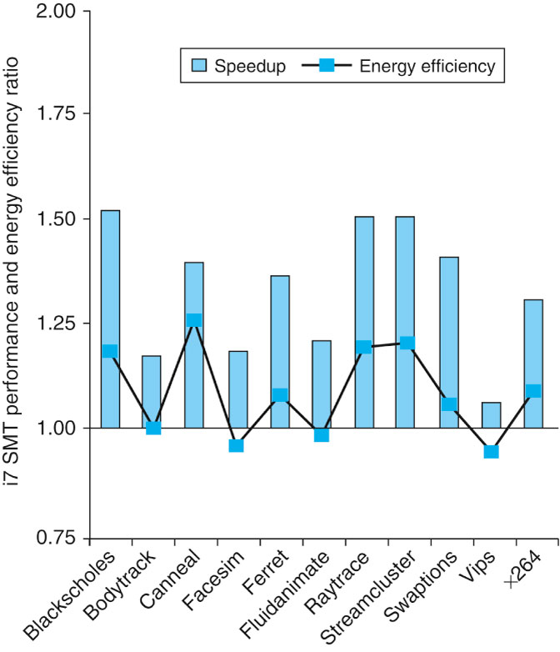
6.4 Multithreading Speedup
FIGURE 6.6 The speed-up from using multithreading on one core on an i7 processor averages 1.31 for the PARSEC benchmarks (see Section 6.9) and the energy efficiency improvement is 1.07. This data was collected and analyzed by Esmaeilzadeh et. al. [2011].

Slide 16
6.5 Multicore and Other Shared Memory Multiprocessors
A shared memory multiprocessor (SMP) is one that offers the programmer a _single_ _physical_ _address_ _space_ across all processors
Processor communicate through _shared_ _variables_ in memory.
SMPs come in two flavors
_UMA_
_NUMA_
Processors need to coordinate when sharing data, this process is called _synchronization_, processors must acquire a _lock_

Slide 17
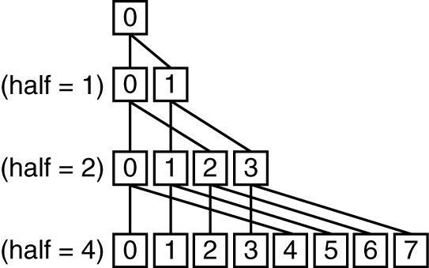
6.5 Shared Address Space Parallel Program (1)
Suppose we want to sum 64,000 numbers on an SMP with UMA. Let’s assume we have 64 processors.
sum[Pn] = 0;
for (i = 1000*Pn; i < 1000*(Pn+1); i = i + 1)
sum[Pn] = sum[Pn] + A[i]; /* sum the assigned areas */
After execution of this code, there are 64 partial sums
Need to combine them into single sum
Do so using a reduction
Notes:
Synchronization required at each step of reduction.

Slide 18
6.5 Shared Address Space Parallel Program (2)
half = 64; /* 64 processors in multiprocessor */
repeat
synch(); /* wait for partial sum completion */
if (half%2 != 0 && Pn == 0)
sum[0] = sum[0] + sum[half-1];
/* Conditional sum needed when half is odd;
Processor0 gets missing element */
half = half/2; /* dividing line on who sums */
if (Pn < half) sum[Pn] = sum[Pn] + sum[Pn+ half];
until (half == 1); /* exit with final sum in sum[0] */

Slide 19
6.5 A Parallel Programming System
A limited but popular example is OpenMP
OpenMP is an Application Programmer Interface along with a set of compiler directives, environment variables, and runtime library routines.
It offers a portable, scalable,and simple programming model for shared memory multiprocessors.
Its primary goal is to parallelize loops and to perform reductions.
OpenMP extends C using pragmas, commands to the C macro processor
Minimum distance = _3_ provides _single_ error correction, double__ error detection

Slide 20
6.5 OpenMP Example
Cc –fopenmp foo.c
#define P 64 /* define a constant */
#pragma omp parallel num_threads(P)
#pragma omp parallel for
for (Pn = 0; Pn < P; Pn +=1)
for (1000*Pn; i < 1000*(Pn +1); i +=1)
sum[Pn] += A[i]; /* sum the assigned areas */
#pragma omp parallel for reduction(+ : FinalSum)
for (i = 0; i < P; i += 1)
FinalSum += sum[i]; /* Reduce to a single number */

Slide 21
6.6 Introduction to Graphics Processing Units
A major driving force for improving graphics processing was the gaming industry, a different development community than the one for CPUs.
Key differences between GPUs and CPUs
GPUs are accelerators that supplement a CPU, they don’t have to do everything.
GPU problems sizes are typically hundreds of megabytes to gigabytes, but not hundreds of gigabytes to terabytes.
Different Architecture Features
GPUs do not rely on multilevel caches, they rely on having enough threads to hide memory latency.
The GPU main memory is oriented towards bandwidth rather than latency.
Each GPU processor is more highly multithreaded than a typical CPU, plus they have more processors.
A major driving force for improving graphics processing was the _______ _______, a different ____________ _________ than the one for CPUs.
GPUs are ___________ that __________ a CPU, they don’t have to do ___________.
The programming __________ to GPUs are high-level __________ _____________ interfaces (APIs), such as OpenGL, coupled with high-level graphics _______ _________. Freedom from backward binary ___________ ____________ leads to _____ _________.
Graphics processing involves drawing _________ and rendering ______.
_________ and ___________ can be done ___________, data-level parallelism.
GPUs do not rely on _________ caches, they rely on having enough _______ to ____ memory latency.
GPUs rely on extensive parallelism to obtain high performance, implementing many _________ __________ and many _________ ________.
The GPU main memory is oriented towards ________ rather than _______.

Slide 22
6.6 Programming GPUs
Initially programmers only had graphics APIs and languages.
They developed C-inspired programming languages
NVIDIA Compute Unified Device Architecture (CUDA)
OpenCL is a multi-company initiative to develop a portable programming language
Unifying theme is CUDA thread
Compiler and hardware can gang thousands of CUDA threads together to utilize multithreading, MIMD, SIMD, and instruction-level parallelism
Threads are blocked together and executed in groups of 32 at a time
A multithreaded processor inside a GPU executes these blocks of threads, and a GPU consists of 8 to 32 of these multithreaded processors.
A major driving force for improving graphics processing was the _______ _______, a different ____________ _________ than the one for CPUs.
GPUs are ___________ that __________ a CPU, they don’t have to do ___________.
The programming __________ to GPUs are high-level __________ _____________ interfaces (APIs), such as OpenGL, coupled with high-level graphics _______ _________. Freedom from backward binary ___________ ____________ leads to _____ _________.
Graphics processing involves drawing _________ and rendering ______.
_________ and ___________ can be done ___________, data-level parallelism.
GPUs do not rely on _________ caches, they rely on having enough _______ to ____ memory latency.
GPUs rely on extensive parallelism to obtain high performance, implementing many _________ __________ and many _________ ________.
The GPU main memory is oriented towards ________ rather than _______.

Slide 23
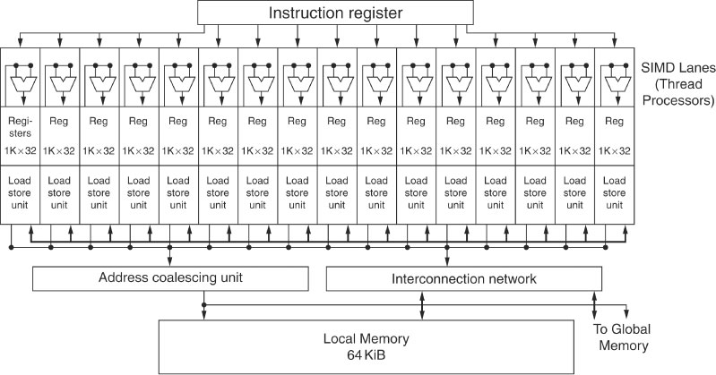
6.6 Block Diagram of SIMD Processor
A major driving force for improving graphics processing was the _______ _______, a different ____________ _________ than the one for CPUs.
GPUs are ___________ that __________ a CPU, they don’t have to do ___________.
The programming __________ to GPUs are high-level __________ _____________ interfaces (APIs), such as OpenGL, coupled with high-level graphics _______ _________. Freedom from backward binary ___________ ____________ leads to _____ _________.
Graphics processing involves drawing _________ and rendering ______.
_________ and ___________ can be done ___________, data-level parallelism.
GPUs do not rely on _________ caches, they rely on having enough _______ to ____ memory latency.
GPUs rely on extensive parallelism to obtain high performance, implementing many _________ __________ and many _________ ________.
The GPU main memory is oriented towards ________ rather than _______.

Slide 24
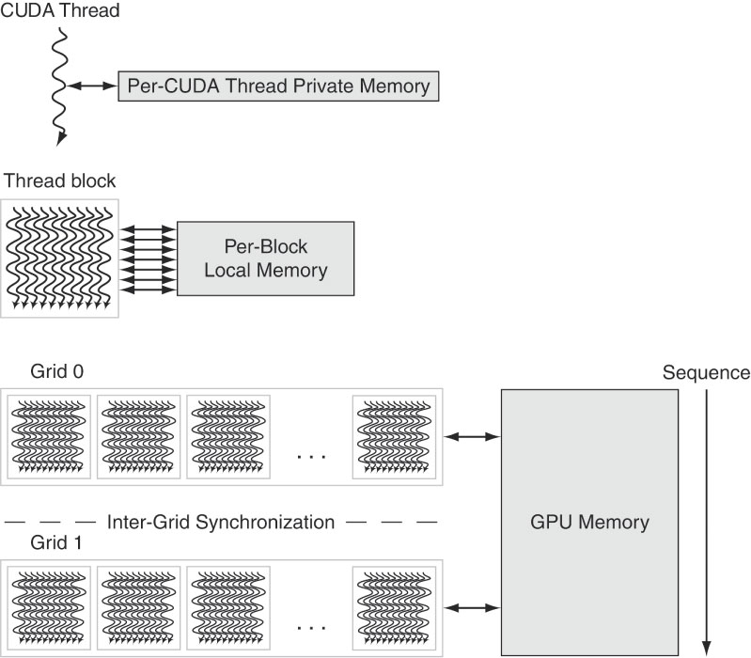
6.6 GPU Memory Structures
A major driving force for improving graphics processing was the _______ _______, a different ____________ _________ than the one for CPUs.
GPUs are ___________ that __________ a CPU, they don’t have to do ___________.
The programming __________ to GPUs are high-level __________ _____________ interfaces (APIs), such as OpenGL, coupled with high-level graphics _______ _________. Freedom from backward binary ___________ ____________ leads to _____ _________.
Graphics processing involves drawing _________ and rendering ______.
_________ and ___________ can be done ___________, data-level parallelism.
GPUs do not rely on _________ caches, they rely on having enough _______ to ____ memory latency.
GPUs rely on extensive parallelism to obtain high performance, implementing many _________ __________ and many _________ ________.
The GPU main memory is oriented towards ________ rather than _______.

Slide 25
6.6 Putting GPUs into Perspective
Feature | Multicore with SIMD | GPU
SIMD processors | 4 to 8 | 8 to 16
SIMD lanes/processor | 2 to 4 | 8 to 16
Multithreading hardware support for SIMD threads | 2 to 4 | 16 to 32
Typical ratio of single precision to double-precision performance | 2:1 | 2:1
Largest cache size | 8 MB | 0.75 MB
Size of memory address | 64-bit | 64-bit
Size of main memory | 8 GB to 256 GB | 4 GB to 6 GB
Memory protection at level of page | Yes | Yes
Demand paging | Yes | No
Integrated scalar processor/SIMD processor | Yes | No
Cache coherent | Yes | No
A major driving force for improving graphics processing was the _______ _______, a different ____________ _________ than the one for CPUs.
GPUs are ___________ that __________ a CPU, they don’t have to do ___________.
The programming __________ to GPUs are high-level __________ _____________ interfaces (APIs), such as OpenGL, coupled with high-level graphics _______ _________. Freedom from backward binary ___________ ____________ leads to _____ _________.
Graphics processing involves drawing _________ and rendering ______.
_________ and ___________ can be done ___________, data-level parallelism.
GPUs do not rely on _________ caches, they rely on having enough _______ to ____ memory latency.
GPUs rely on extensive parallelism to obtain high performance, implementing many _________ __________ and many _________ ________.
The GPU main memory is oriented towards ________ rather than _______.

Slide 26
6.7 Message Passing Multiprocessors
When an address space is not ________, communication occurs via explicit ________ _________.
________________ occurs using ______ and ________ messages.
___________ parallelism and applications with little ______________ do not require ________ addressing to run well. Examples include _____ ________, ______ _________, and ______ ________.
_______ _________ inter-connection networks have been used, they provide _____ performance at ____________ cost than LANs.
More ________ are _________ that are collections of computers connected via _________ networks.

Slide 27
6.7 Message Passing Program
sum = 0;
for (i = 0; i<1000; i = i + 1) sum = sum + AN[i];
limit = 100; half = 100;/* 100 processors */
repeat half = (half+1)/2; /* send vs. receive dividing line */ if (Pn >= half && Pn < limit) send(Pn - half, sum);
if (Pn < (limit/2)) sum = sum + receive(); limit = half; /* upper limit of senders */ until (half == 1); /* exit with final sum */

Slide 28
6.7 Hardware/Software Interface
Message passing systems are easier for _______-___ designers to _____.
For programmers, there are fewer ____ _______, the communication is explicit, there is no guessing about the ______ ___________ performance
However, it’s harder to ____ a _____________ program to a message-passing computer.
Modern systems are a ______; ________ multiprocessors use ________ physical memory and _____of a _______ communicate with each other using ________ _______.
The weakness of __________ memories for user memory from a parallel programming perspective turns into a strength in system _____________.
Computers can be _________ in a cluster without __________ the system _____.
Work can also be more easily _____________ from ________ servers.
Systems can be more easily __________ using _______.

Slide 29
6.7 Warehouse Scale Computers (WSCs)
The most popular framework for batch processing in a WSC is MapReduce and the open source version, Hadoop, inspired by _____ functions of the same name.
WSCs require innovations in ________ ____________, _________, _____________, and ___________, they are a modern descendant of the 1970s supercomputer.
The 1970s supercomputer provided the _____ ____________ that could afford it, high performance computing for ____________ and _____________
Warehouse Scale Computers make it possible for us to have __________ ____________ on _________.

Slide 30
6.7 Warehouse Scale Computers (WSCs)
WSCS have three major distinctions
_______, _____ parallelism - or _______________ parallelism
___________ Costs Count – not just ________ price, energy, power distribution, and cooling represent more than ______ of the costs of a WSC over ___ _______
_______ and the Opportunities/Problems Associated with ______
100,000 servers mean ________ __________
______ on servers can be ____
100,000 servers mean lots of _________- ______ and ________
______ __________ takes on more importance

Slide 31
6.7 Warehouse Scale Computers (WSCs)
In _______, Amazon Web Services announced the amount of new server capacity it adds _______ ____ is sufficient to support all of Amazon in 2003 when it was a company with ______ employees and _____________ in annual revenue.
The growth of cloud computing could be slowed by _________ concerns, __________ concerns, ______________ and the _____ of ___________ of Internet bandwidth.
https://www.youtube.com/watch?v=zRwPSFpLX8I
https://www.youtube.com/watch?v=XZmGGAbHqa0

Slide 32
6.8 Introduction to Multiprocessor Network Topologies
The popularity of ________ _____________ leads to a need for _________________ networks between _______ in a warehouse scale computer.
The increasing number of ______ per chips means we need networks ______ a chip as well.
Network costs include the _________ of _________ , the _______ of ______ on a switch to connect to the network, the _______ per _____, and ________ of the link when the network is mapped onto _______.
Network performance includes
The _________ on an ____________ network to send and receive a message
The ____________ in terms of the ___________ number of messages that can be _________________ in a given time period
________ caused by _______________ for a portion of the network
Variable performance depending on the _________ of communication.
________ ______________
________ ______________

Slide 33

6.8 Introduction to Multiprocessor Network Topologies
Networks are normally drawn as graphs
______ represents _____
______ represents ___________
Links are __________________
Networks consist of ___________
First example is a _____
Capable of ______ _______________ transfers

Slide 34
6.8 Network Performance Metrics
Network Bandwidth - the bandwidth of _____ _____ multiplied by the ________ of ______ (_____ _____)
Ring -
Bus –
Bisection Bandwidth (______ _____) – the _____ of the bandwidth of the links that _______ the _________ between the two _________ of a machine
Ring –
Bus –
Some network topologies are not _____________
Where do we draw the line?
Calculate ____ ___________ bisection bandwidths and pick the _________
Parallel programs are often __________ by the __________ link in the communication chain
Diameter – __________ _________ between two processors

Slide 35
6.8 Network Topologies
Each processor in a _____ network connects to ____ other processors
Diameter of the network _____
In a ______ __________ network, every processor has a link to ______ _______ processor
Network bandwidth – _____________
Bisection bandwidth – ______
Diameter ___
High _____________ at high _____
Many networks have been proposed between these two __________- their success largely depends on the _________________ __________ of parallel programs
Only a few have been used in _________________ parallel processors

Slide 36
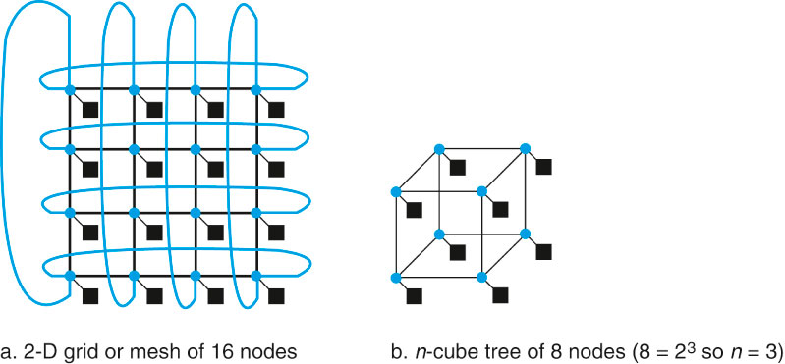
6.8 Commercial Parallel Processor Topologies

Slide 37
6.8 Multistage Networks
Each processor in a ring network connects to two other processors
Diameter of the network P-1
In a fully connected network, every processor has a link to every other processor
Network bandwidth – P x (P – 1)/2
Bisection bandwidth – (P/2)²
Diameter 1
High performance at high cost
Many networks have been proposed between these two extremes - their success largely depends on the communication workload of parallel programs
Only a few have been used in commercial parallel processors

Slide 38
6.8 Multistage Networks
Each processor in a ring network connects to two other processors
Diameter of the network P-1
In a fully connected network, every processor has a link to every other processor
Network bandwidth – P x (P – 1)/2
Bisection bandwidth – (P/2)²
Diameter 1
High performance at high cost
Many networks have been proposed between these two extremes - their success largely depends on the communication workload of parallel programs
Only a few have been used in commercial parallel processors

